Slide 1
DCAITI-Project:
Intelligent rear-view mirror for cyclist on Smartphones
Oday Kabha oday.kabha@ipk.fraunhofer.de
Shan Han hanshann09@gmail.com
name @mailbox.tu-berlin.de
Supervisor: Marcus Witzke

Slide 2
Overview
Idea
Develop Framework
System Architecture
Solution Approaches
Milestone
18.11.2020
DCAITI -Projekt

Slide 3
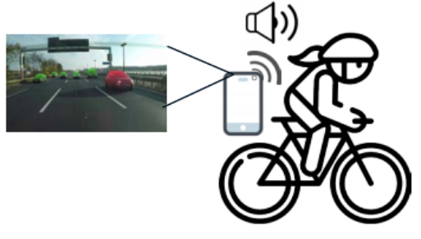
1. Idea
Object Detection & Tracking:
Smartphone cam
Additional cam
Image processing Algorithms
Measurement of Distance & Speed:
Simple smartphone cam using image processing algorithms
LiDAR
Notifications & Warnings
When objects too close or too fast
Android Notification Reciever
Source: Introduction slides of Marcus
04.05.2021
DCAITI -Projekt

Slide 4
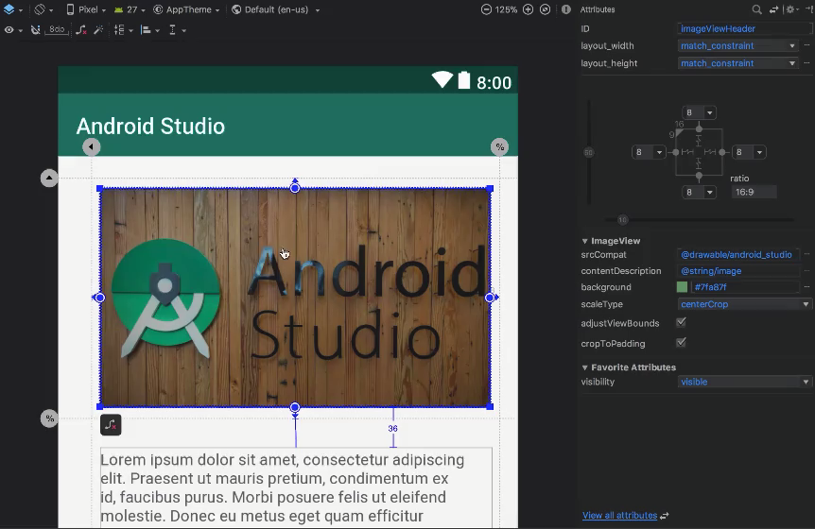
2. Develop Framework
Android Studio
Visual layout editor
build layouts by dragging UI elements instead of writing layout XML by hand
Source: https://developer.android.com/studio
04.05.2021
DCAITI -Projekt

Slide 5

2. Develop Framework
Android Studio
Fast emulator
run apps on the Android Emulator
Source: https://developer.android.com/studio
04.05.2021
DCAITI -Projekt

Slide 6
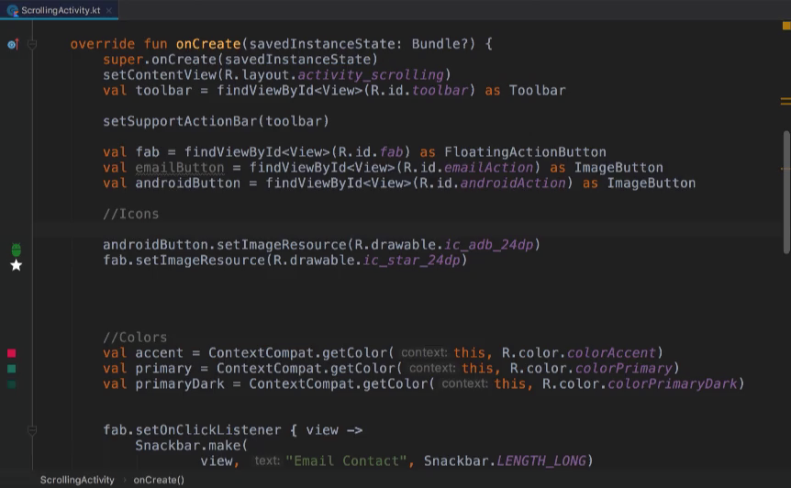
2. Develop Framework
Android Studio
3. Intelligent code editor
based on IntelliJ IDEA
Source: https://developer.android.com/studio
04.05.2021
DCAITI -Projekt

Slide 7
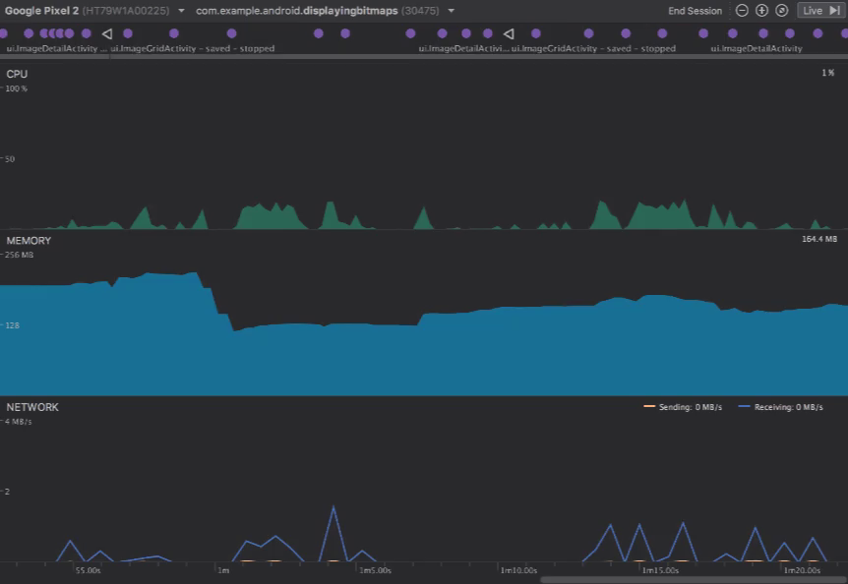
2. Develop Framework
Android Studio
4. Realtime profilers
measure app performance
Source: https://developer.android.com/studio
04.05.2021
DCAITI -Projekt

Slide 8
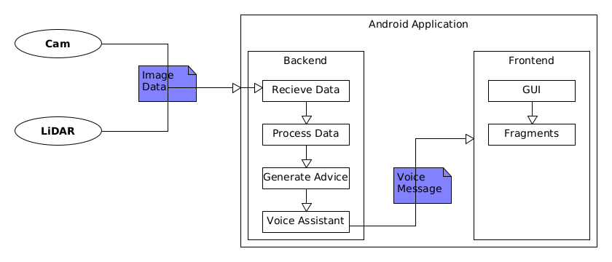
3. System Architecture
04.05.2021
DCAITI -Projekt

Slide 9
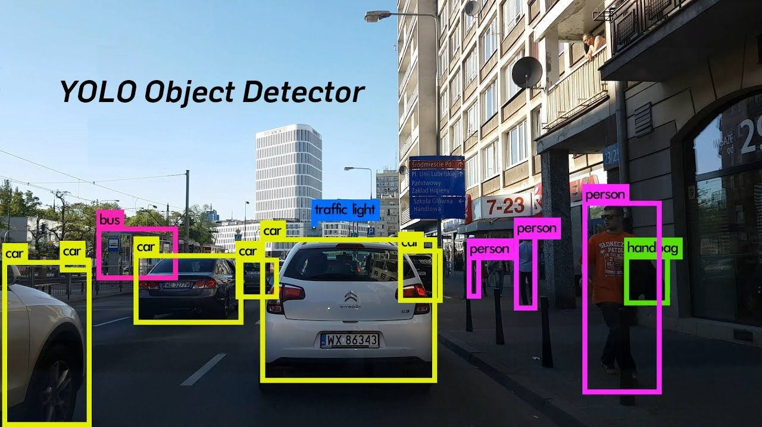
4. Solution Approaches
Vehicle Detection
YOLO (You only look once)
MaskRCNNs
Detectron2
04.05.2021
DCAITI -Projekt

Slide 10
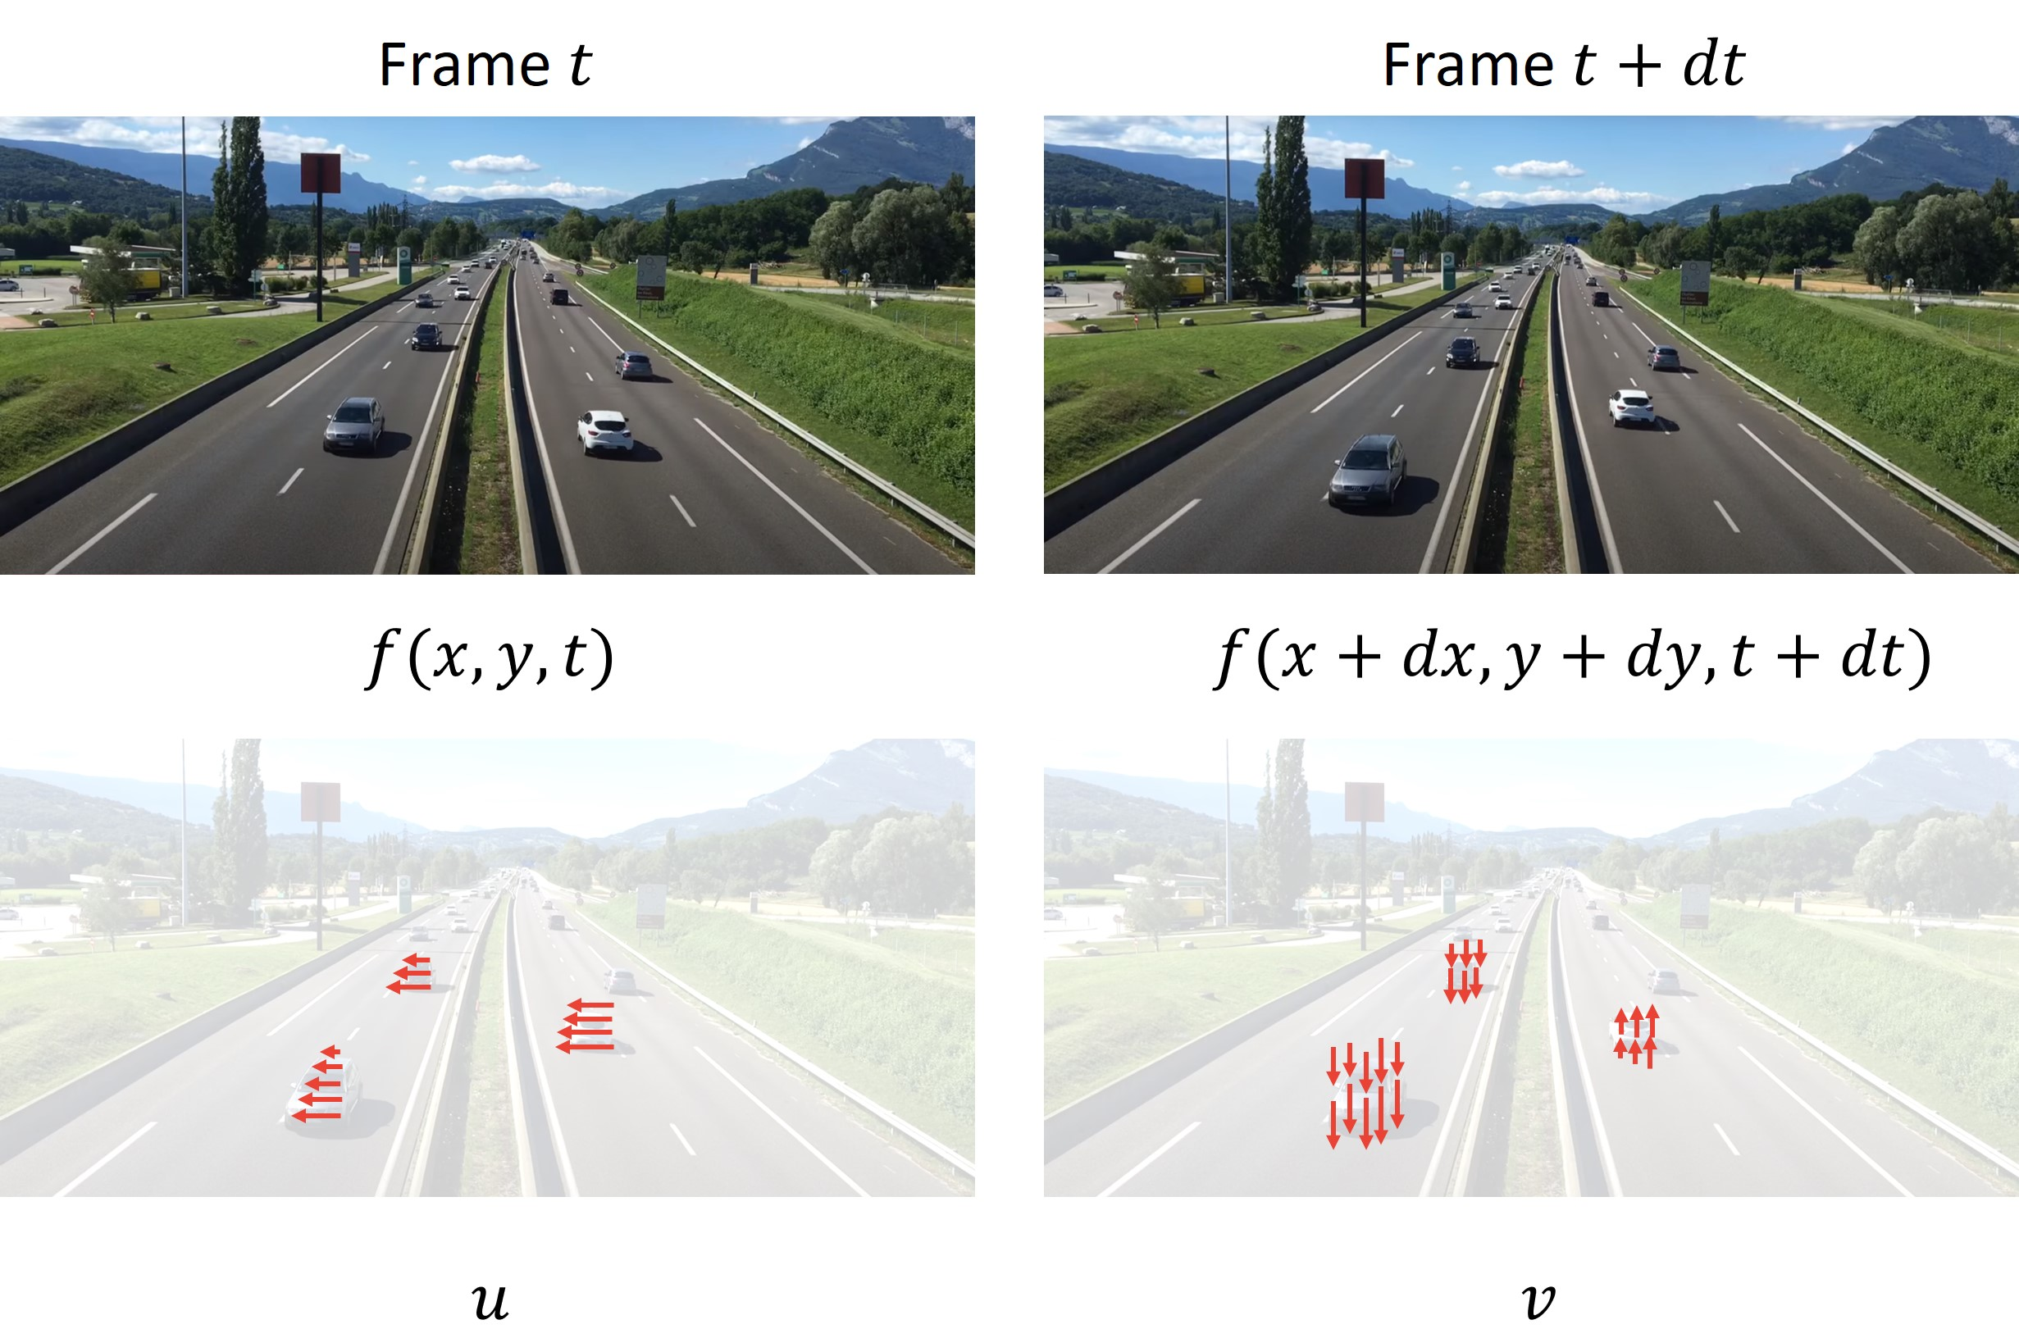
4. Solution Approaches
Tracking
Sparse Optical Flow
Lucas-Kanade-Methode
Elementary Motion Detector
04.05.2021
DCAITI -Projekt

Slide 11
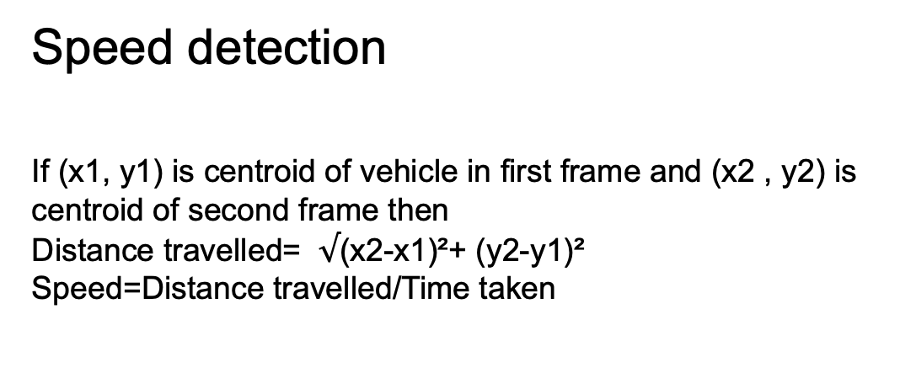
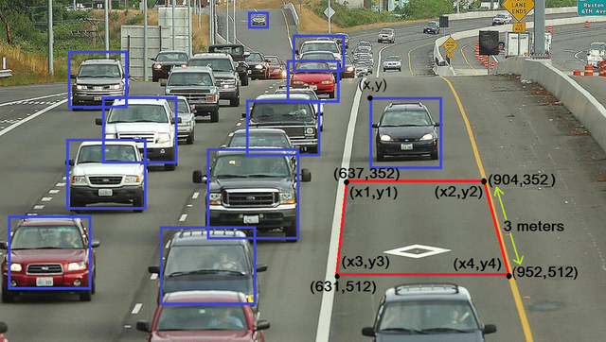
4. Solution Approaches
Speed detection
If (x1, y1) is centroid of vehicle in first frame and (x2 , y2) is
centroid of second frame then
Distance travelled= (x2-x1)²+ (y2-y1)²
Speed=Distance travelled/Time taken
04.05.2021
DCAITI -Projekt
Notes:
Distance is calculated using the centroids of previous and next
frames. For distance calculation, Euclidean distance is used.
Time is calculated as vehicle enters the ROI. Initially the
speed is calculated using the formula

Slide 12
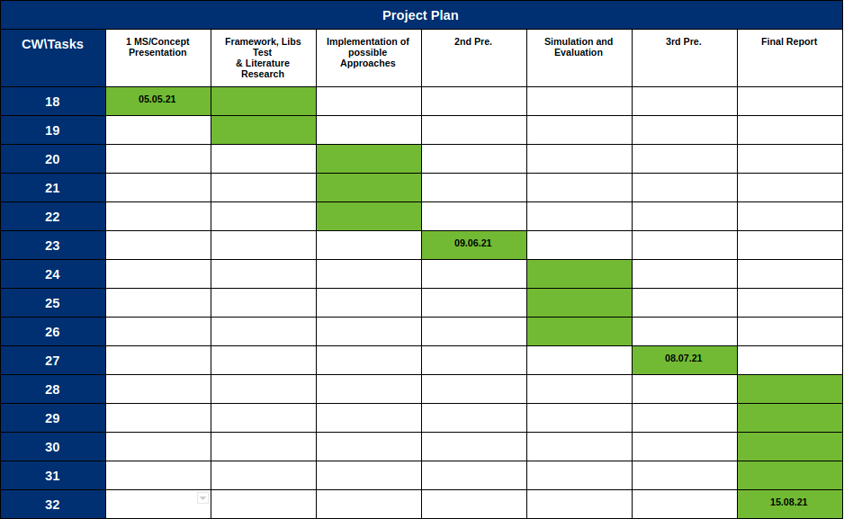
3. Milestone
04.05.2021
DCAITI -Projekt

Slide 13
Thanks for your attention!
Oday Kabha oday.kabha@ipk.fraunhofer.de
Shan Han hanshann09@gmail.com
name name@mailbox.tu-berlin.de

